Slide 1



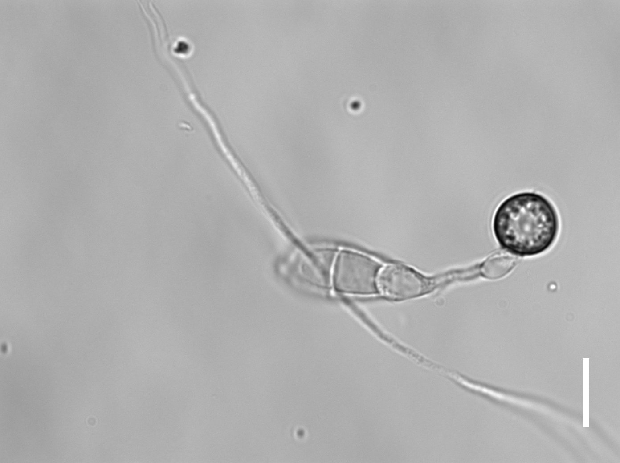
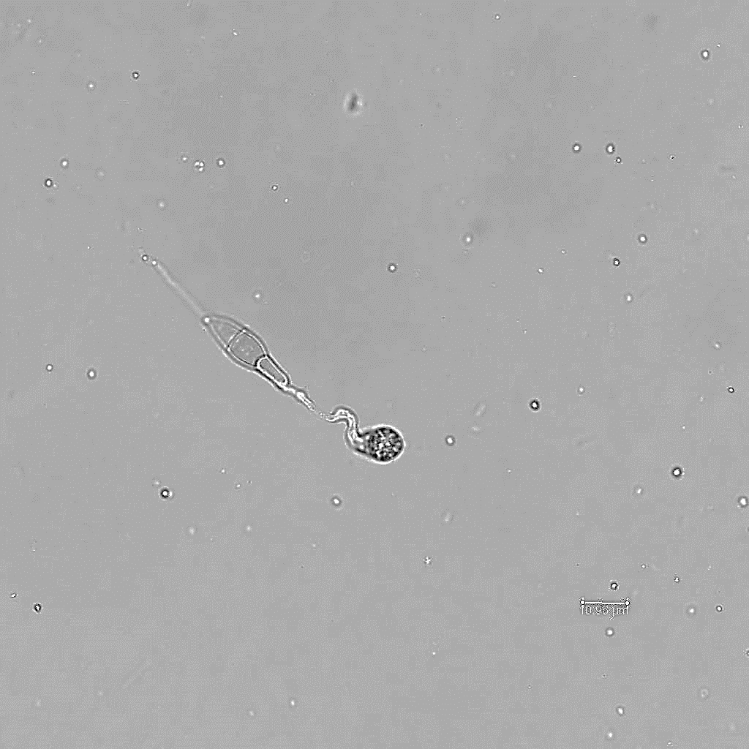
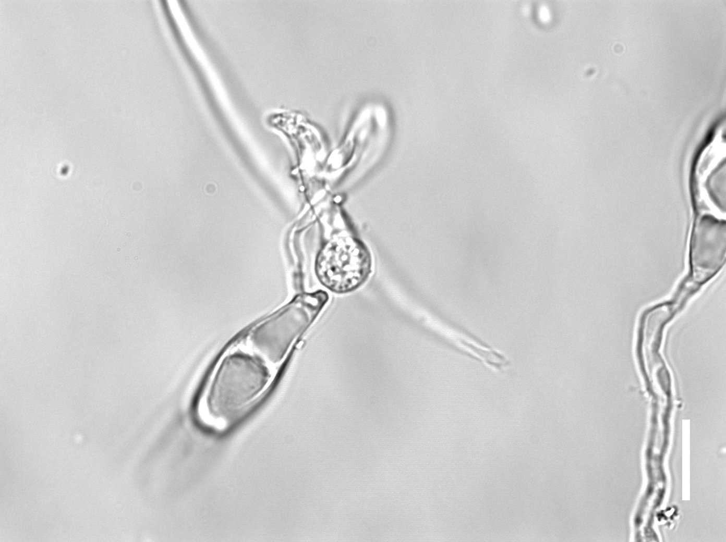
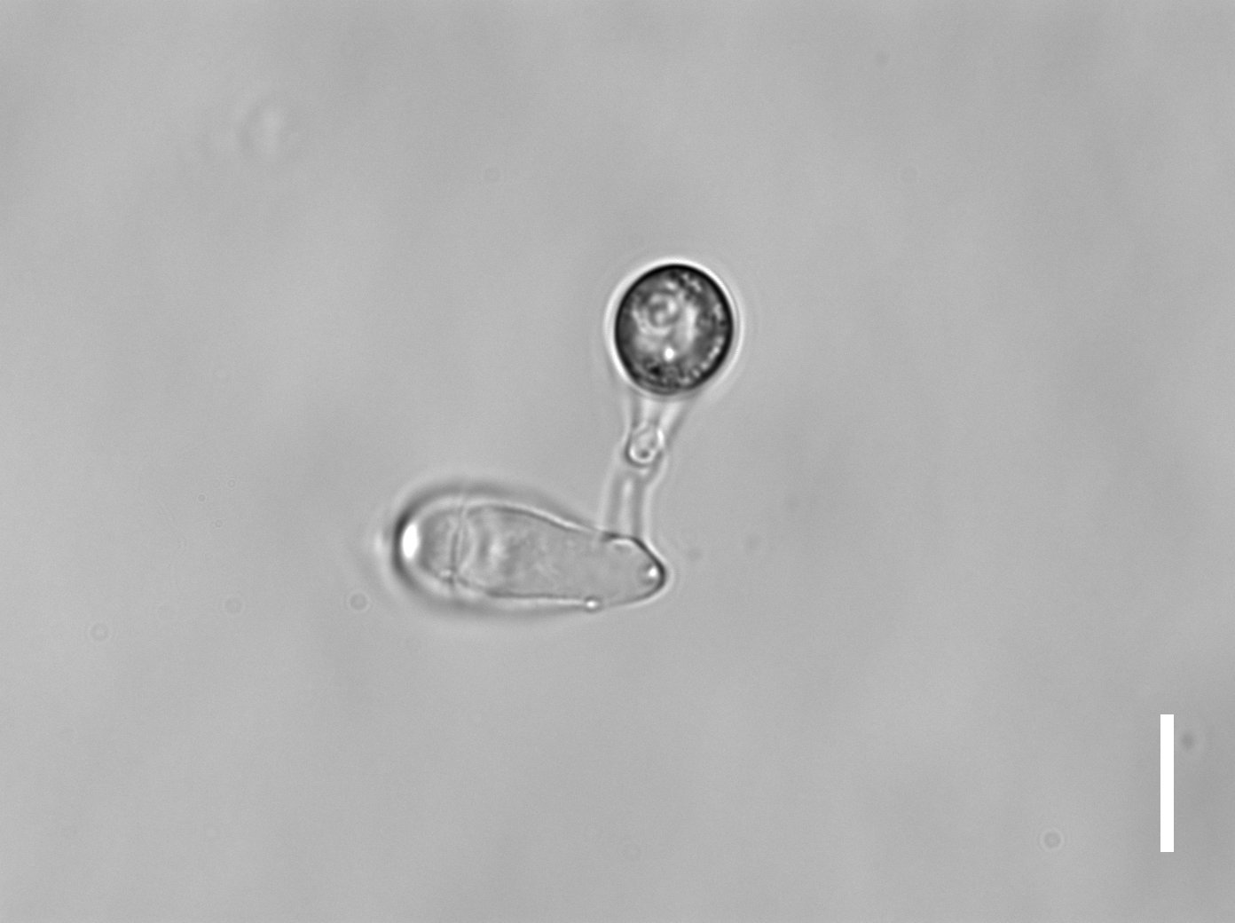
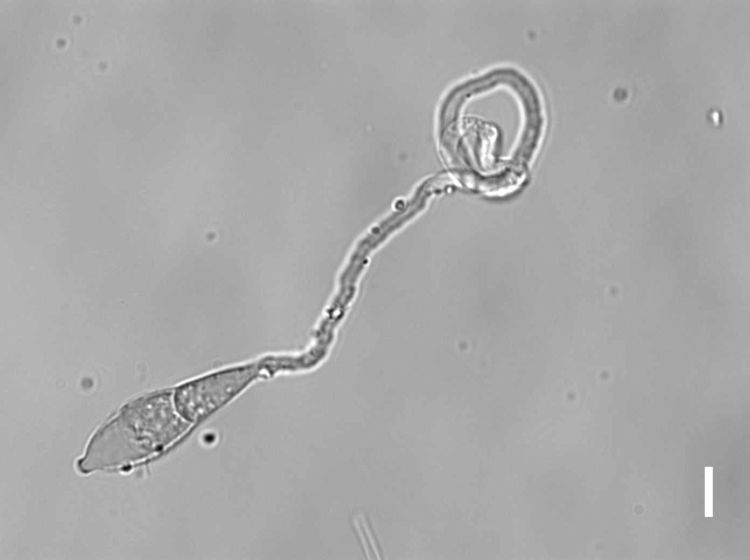
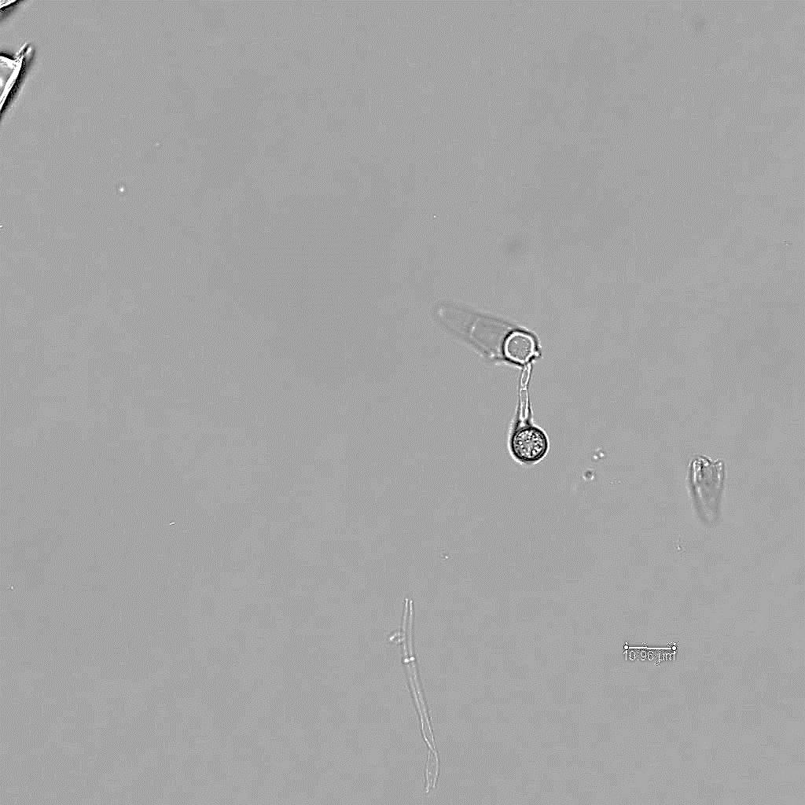
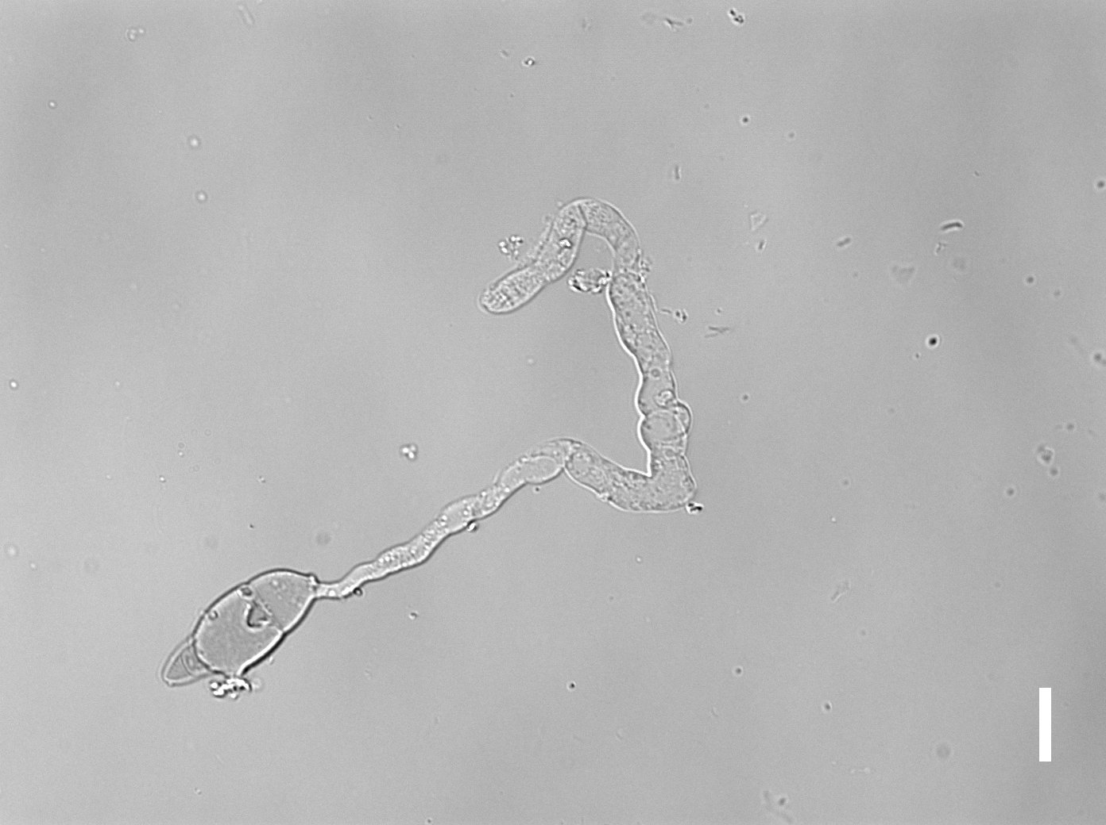
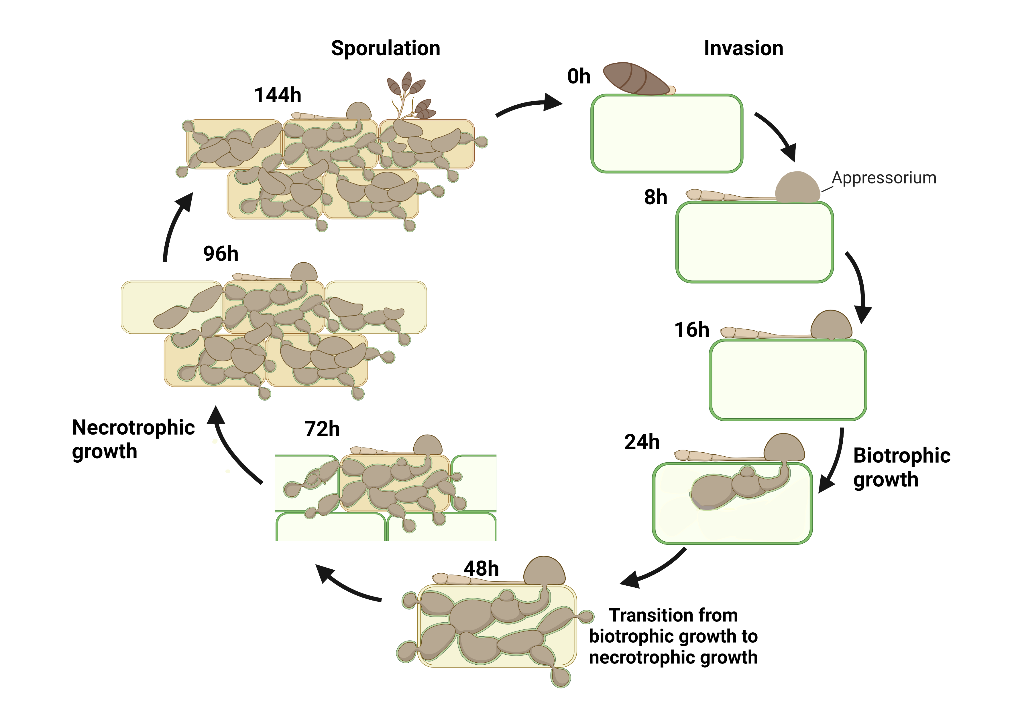
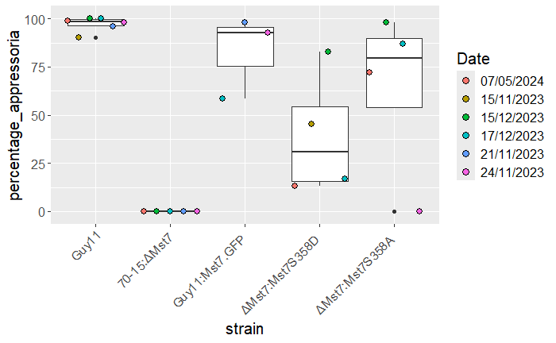
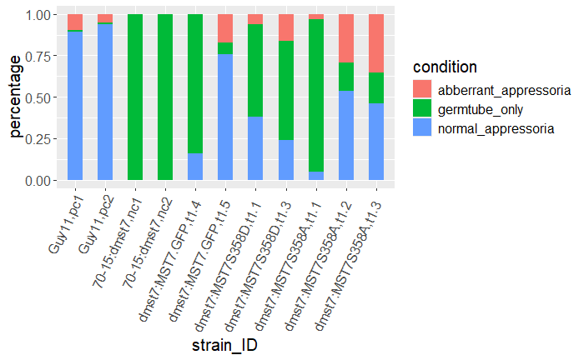
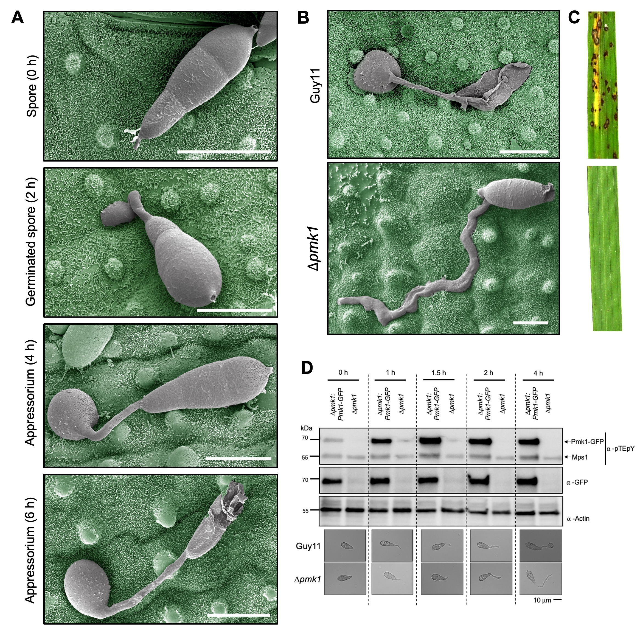

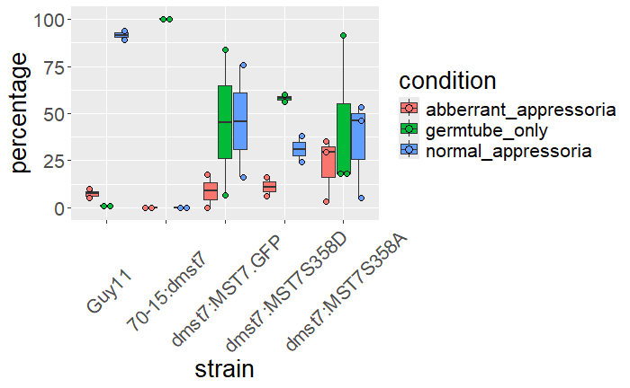
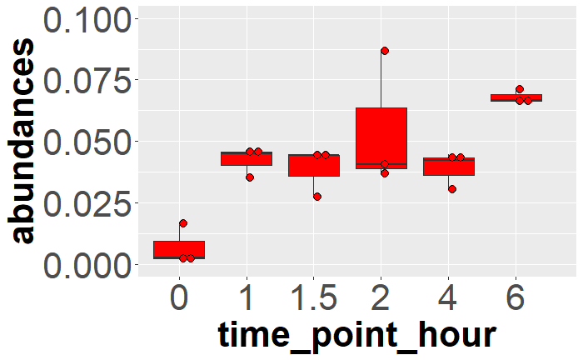
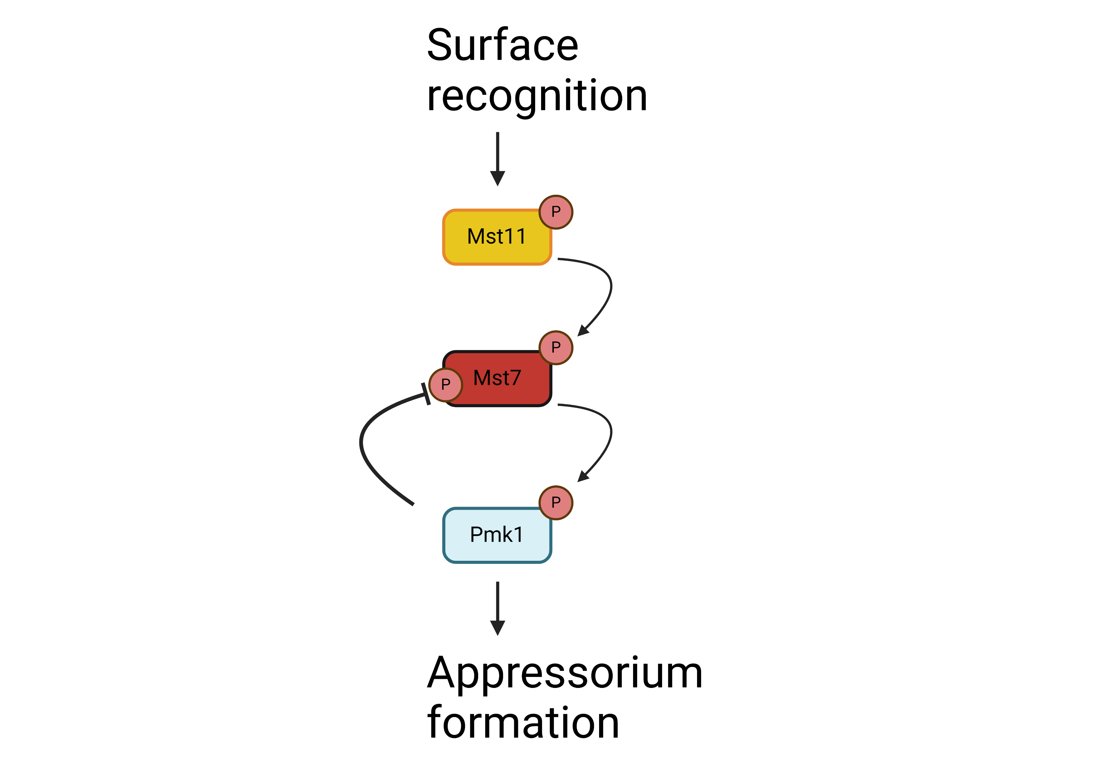
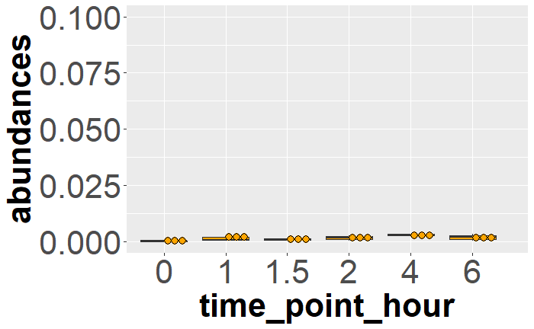
Feedback Regulation Of The Pmk1 Mitogen-Activated Protein Kinase Pathway During Infection-Related Development In The Rice Blast Fungus
Authors: Euan Cawston¹, Neftaly Cruz-Mireles¹, Prince Amoah¹, Lauren Ryder¹, Nicholas J. Talbot¹ and Frank L.H. Menke¹
¹The Sainsbury Laboratory, University of East Anglia, Norwich Research Park, Norwich, United Kingdom.
Background • Yearly 30% of global rice crop yields are lost due to blast disease caused by Magnaporthe oryzae
•Pathogenicity Mitogen activated protein Kinase 1 (Pmk1) is essential for M.oryzae infection-related development
•Pmk1-dependent phosphosites have been identified in the upstream activating kinases Mst7 and Mst11
Objective • Determining detailed regulation of the Pmk1 cascade at molecular level
Summary • Phosphorylation of Ser358 in Mst7 is shown to negatively regulate the Pmk1 cascade
Significance •These results demonstrate a novel mode of regulation for the Pmk1 pathway during infection-related development
The phosphomimic Mst7^{S358D} allele abrogates appressorium formation
Guy11
70:15: ∆mst7
70-15:
∆mst7:MST7 .GFP
70-15:
∆mst7:MST7 ^{S358D} .GFP
70-15:
∆mst7:MST7 ^{S358A} .GFP
10µm
10µm
10µm
10µm
10µm
M. oryzae infection cycle
Figure 3. Substitution of a serine residue 358 for a negatively charged aspartate residue mimics phosphorylation of the serine residue. Introducing this substitution to a Pmk1 dependent phosphosite in Mst7 reduced appressorium formation suggesting it is a negative regulator of the Pmk1 cascade. Western blot analysis shows expression of constructs
The Phosphomimetic Mst7^{S358D} shows lower frequency of appressorium formation than wild type
A
Figure 4. A) Quantification of appressoria formation showed that frequency in the ∆mst7 complemented with MST7p:MST7^{S358D}:GFP is lower than wild type. B) Quantification of the frequency of normal appressoria, aberrant appressoria, or germtube only for two to three single spore isolates (t) of complimented ∆mst7 strains showed a higher frequency of germtube only than wild type for ∆mst7 complemented with MST7p:MST7^{S358D}:GFP. Protein expression was assessed by fluorescence microscopy and was lower for one isolate (*). Quantification of controls was performed twice. These data further support the hypothesis that phosphorylation of Serine 358 in Mst7 negatively regulates the Pmk1 cascade.
B
Figure 1. A schematic representation of different developmental stages of the M. oryzae life cycle during infection of a rice plant. A specialised cell, called an appressorium, is required for penetration of the leaf surface, essential for successful infection of the host and completing the life cycle.
*
Pmk1 is a key regulator of appressorium formation
controls
single spore isolates
A
C
E
MGG_00800 [351-366] SHLAPQL[S]PATADLLR
Controls
Future questions
What is the role of other non-canonical Pmk1 dependent phosphosite in Mst7?
Does phosphorylation of Mst7 S358 affect pathogenicity and Pmk1 activity?
Guy11
Conclusion
B
D
10µm
F
MGG_00800 [351-366] SHLAPQL[S]PATADLLR
pmk1
10µm
Funding and Acknowledgments
This PHD is funded by BBSRC as part of the NRP DTP.
A big thank you to Weibin Ma, Mark Jave Bautista,
Mattthew Wengler, Angus Bucknell, and Markus Draeger
for technical support. Thank you to Kim Findley for SEM
imaging. I’d also like to thank to Paul Derbyshire and Jan
Sklenar for their advice.
Figure 2. Wild type M. oryzae (Guy11) can infect rice leaf A and form appressoria C. Pmk1 null mutant (pmk1) fails to infect rice leaf B or form appressoria D. A phosphosite in Mst7 is detected in wild type M. oryzae E but not in pmk1 mutant F suggesting this site is a target of Pmk1 phosphorylation. Cruz-Mireles et al., 2024. Phosphorylated residue shown in square brackets.

